Slide 1
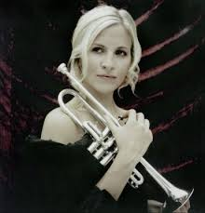
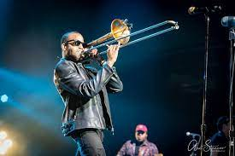
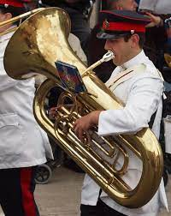
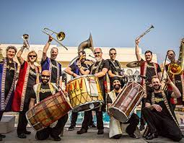
Welcome back to…..
Planet Brass!
With Mr. Rose

Slide 2
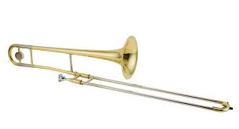
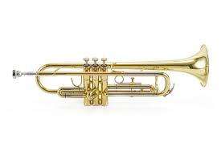
Autumn Term ….. Bollywood Brass
Lesson 9 – Bhangra Groove!

Slide 3
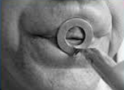
Revision – How to BUZZ
3. Leave a small gap (aperture)
1. Tiger Teeth
2. Feed the tiger
4. Put a mouthpiece to your lips

Slide 4
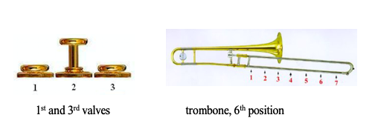
Copy Me – Answer me……
Either copy the melodic phrase you hear
or answer it with one of your own.
D
C
Notes:
Perform a line at a time,
Do in 3 groups, group 2 start after group 1 finishes first line

Slide 5
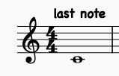
Let’s Play….
The MIDDLE 8

Slide 6
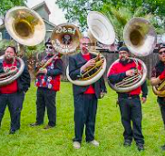
The Sousaphone
Named after an American band leader, John Philip Sousa. It wraps around the player to make it easier to march with!

Slide 7
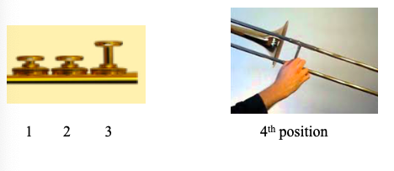
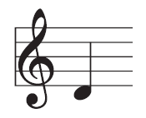
E
D
C

Slide 8
Write the notes C, D and E
TRY
Reading & writing music
Draw 5 lines
Try drawing a treble clef

Slide 9
Bhangra Groove
1.
2.
Learn each melodic phrase – 1, 2 and 3
3.

Slide 10
What have we learned in Lesson 9 of Bollywood Brass?
About the sousaphone
Playing and reading the notes
C , D and E
How to draw a treble clef and write the notes C, D and E
Answering and Improvising
Bhangra Groove

