Slide 1
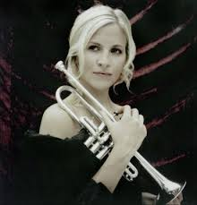
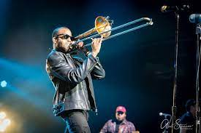
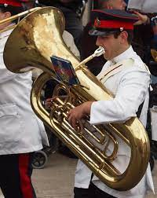
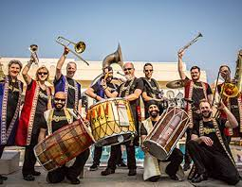
Welcome back to…..
Planet Brass!
With Mr. Rose

Slide 2
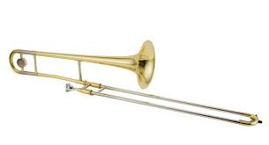
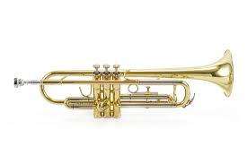
Autumn Term ….. Bollywood Brass
Lesson 8 – Masala Mix!

Slide 3
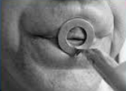
Revision – How to BUZZ
3. Leave a small gap (aperture)
1. Tiger Teeth
2. Feed the tiger
4. Put a mouthpiece to your lips

Slide 4
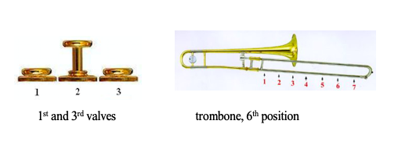
Improvising……
making it up on the spot
using the note C & D and your own rhythms!
D
C
Notes:
Perform a line at a time,
Do in 3 groups, group 2 start after group 1 finishes first line

Slide 5
Write the notes C & D
TRY
Reading & writing music
Draw 5 lines
Try drawing a treble clef

Slide 6
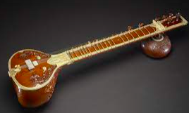
sitar

Slide 7
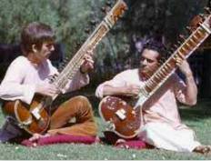
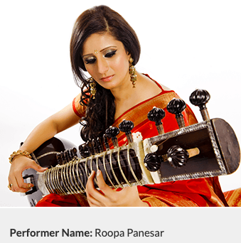
George Harrison and Ravi Shanker
(One of the Beatles)

Slide 8
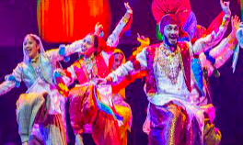
Play Bhangra Style using the note C
We’re gonna play in Bhangra Style
We’re gonna play in Bhangra Style
Yes…..Yes……. We will play it like this

Slide 9
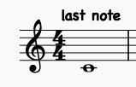
The MIDDLE 8

Slide 10
What have we learned in Lesson 8 of Bollywood Brass?
About the sitar
Playing and reading the notes
C and D
How to draw a treble clef
Improvising
Following a conductor

