Slide 1
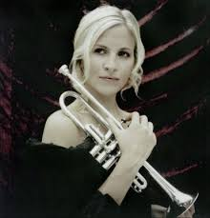
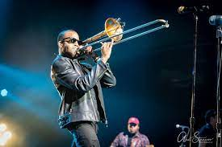
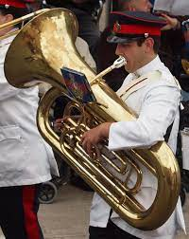
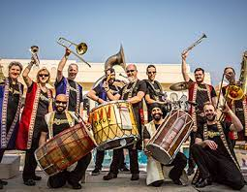
Welcome back to…..
Planet Brass!
With Mr. Rose

Slide 2
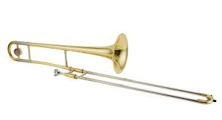
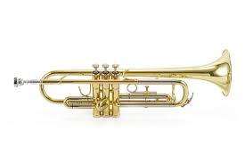
Autumn Term ….. Bollywood Brass
Lesson 7 – Brass!!

Slide 3
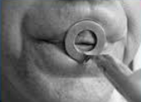
Revision – How to BUZZ
3. Leave a small gap (aperture)
1. Tiger Teeth
2. Feed the tiger
4. Put a mouthpiece to your lips

Slide 4
Improvising……
making it up on the spot
using the note C and your own rhythms!
Notes:
Perform a line at a time,
Do in 3 groups, group 2 start after group 1 finishes first line

Slide 5
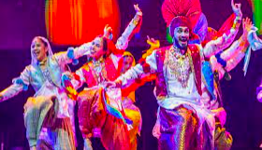
Let’s play ‘Bhangra Style’! – with the trumpet/trombone

Slide 6
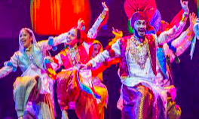
Play Bhangra Style using the note C
We’re gonna play in Bhangra Style
We’re gonna play in Bhangra Style
Yes…..Yes……. We will play it like this

Slide 7
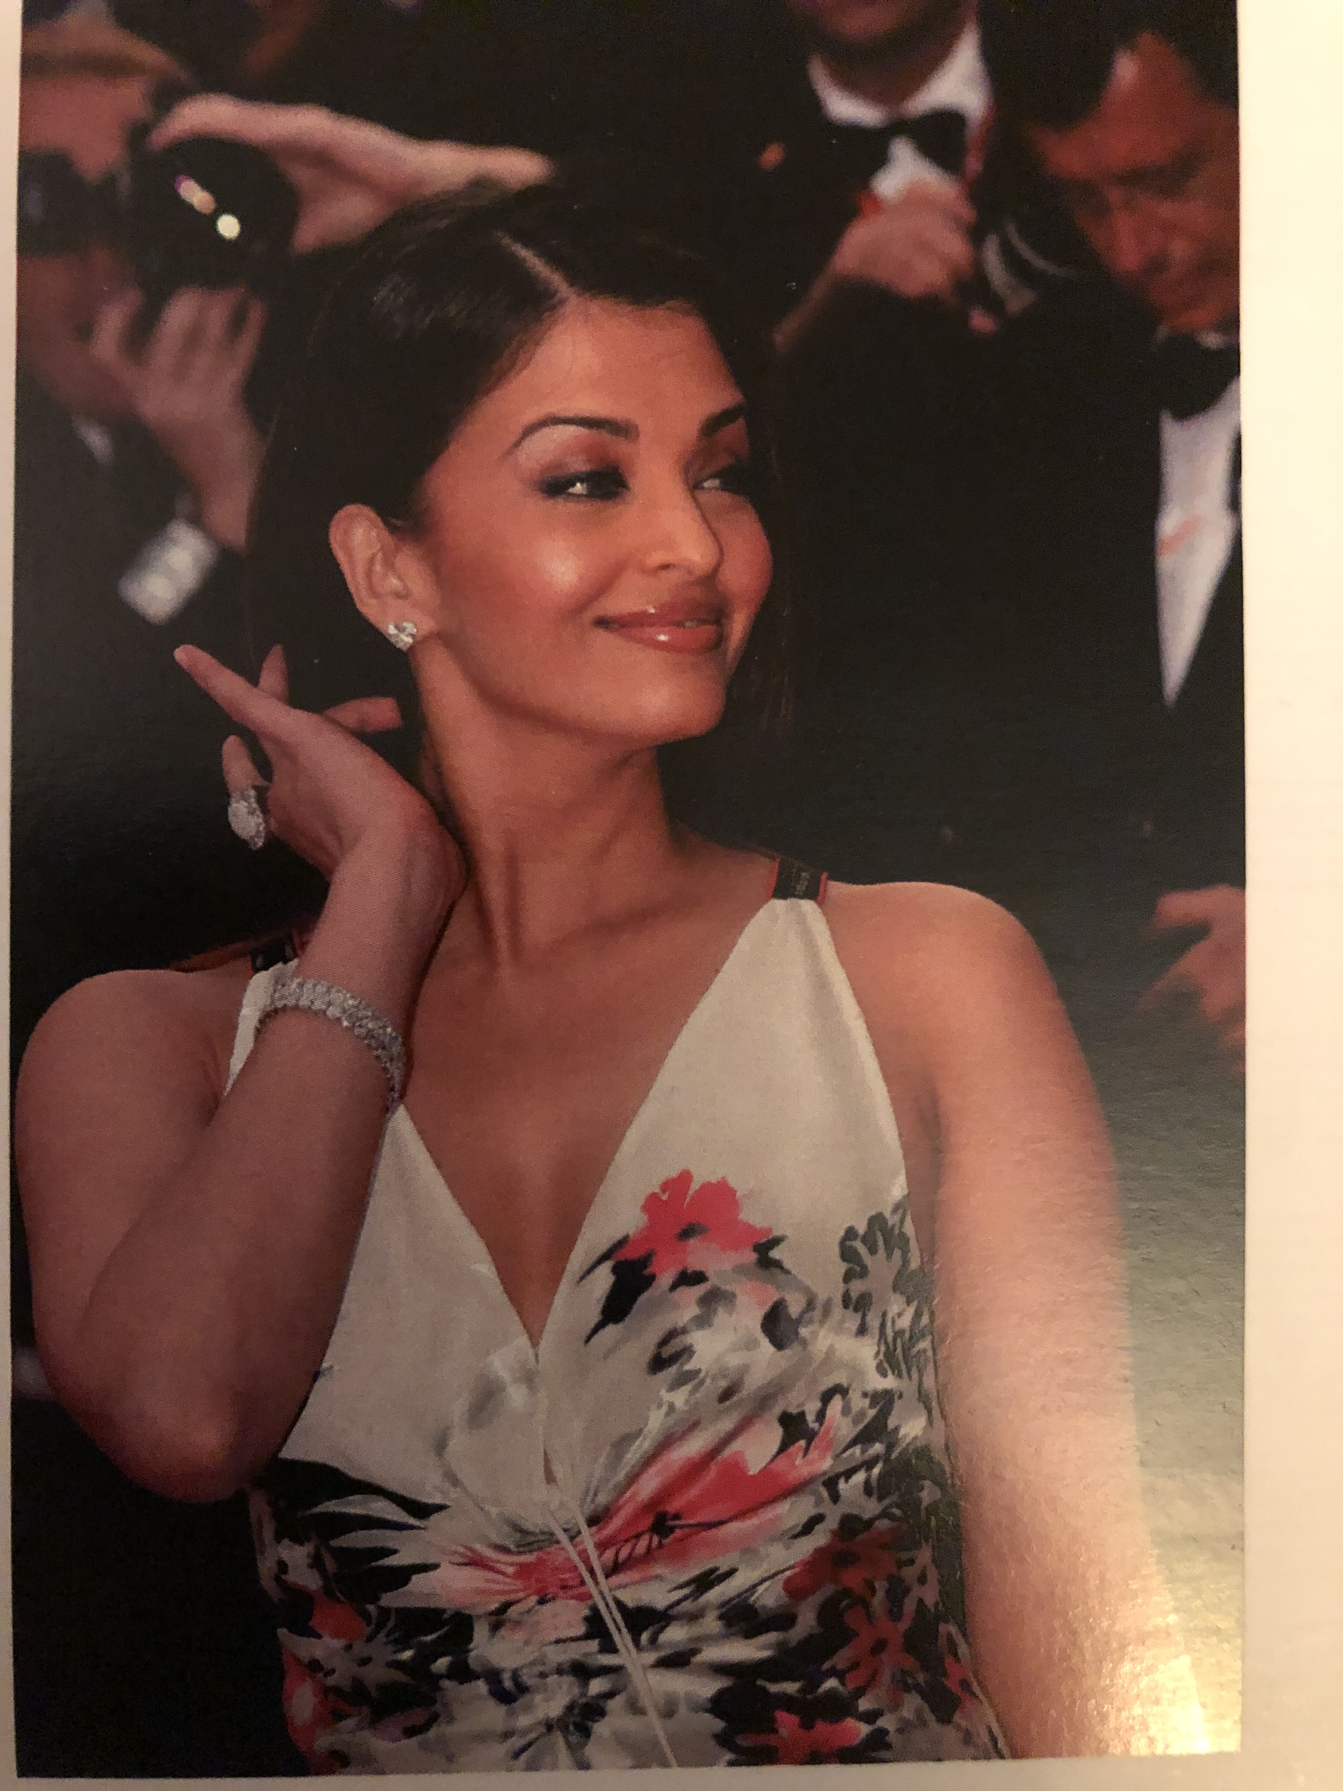
Bollywood Stars
Aishwarya Rai
She is one of the most famous Bollywood Film Actresses.
Her husband and son are also Bollywood actors.
Her wax figure is in Madam Tussauds!

Slide 8
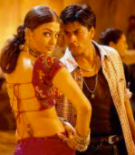
Bunty Aur Babli (transl. Bunty and Babli)
This is a 2005 Indian Hindi-language comedy film.
It’s about 2 con-artist partners-in-crime, Bunty and Babli, who are being chased by the police.
This song ‘Kajra Re’ appears in the film. It’s a song about the black make-up around her eyes.

Slide 9
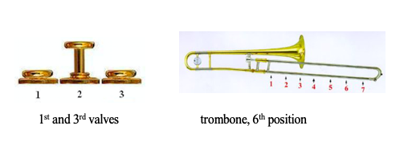
The notes C and D
D
C

Slide 10
Let’s play C and D
Copy the teacher. Listen to any changes in pitch. It always starts on C!
Answer the teacher using C and D

Slide 11
Write the notes C & D
TRY
Reading & writing music
Draw 5 lines
Try drawing a treble clef

Slide 12
What have we learned in Lesson 7 of Bollywood Brass?
About a Bollywood actress
Playing and reading the notes
C and D
How to draw a treble clef
Improvising
Following a conductor

