Slide 1

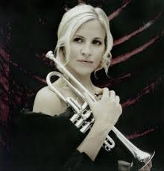
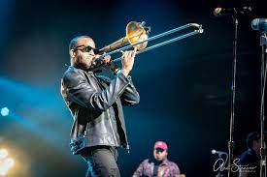
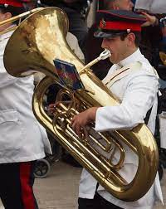
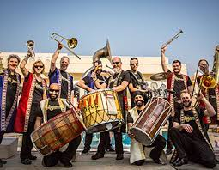
Welcome back to…..
Planet Brass!
With Mr. Rose

Slide 2
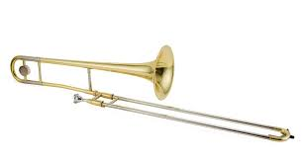
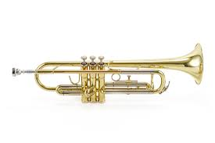
Autumn Term ….. Bollywood Brass
Lesson 6 – Brass!!

Slide 3
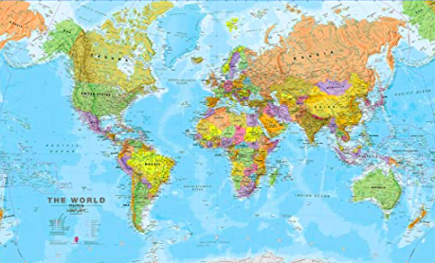
Where in the world is India and Pakistan?……

Slide 4
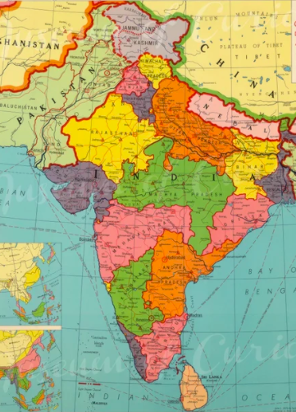

What Is Bhangra Music?
Bhangra music has origins in the Punjab region of Northeast Pakistan and Northern India.

Slide 5
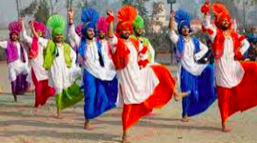
Dance to Bhangra Music?
Traditional bhangra dance features several dancers in a circle. They move energetically, often with raised arms or shoulders – Single Dhamaal
It was originally a rural dance performed at harvest festivals,

Slide 6




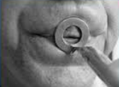
Revision – How to BUZZ
3. Leave a small gap (aperture)
1. Tiger Teeth
2. Feed the tiger
Single Dhamaal
4. Put a mouthpiece to your lips

Slide 7
Improvising……
making it up on the spot
using the note C and your own rhythms!
Notes:
Perform a line at a time,
Do in 3 groups, group 2 start after group 1 finishes first line

Slide 8
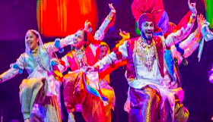
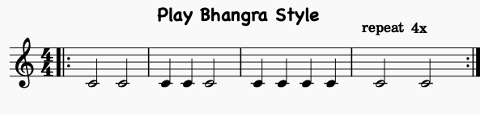
Let’s play Bhangra Style! – with the trumpet/trombone

Slide 9
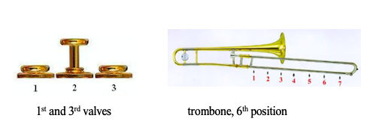
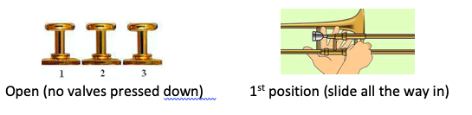
The notes C and D
D
C

Slide 10
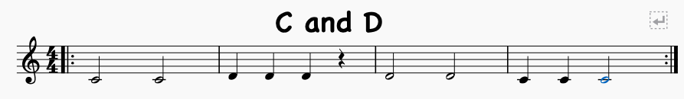
Let’s play C and D
Copy the teacher. Listen to any changes in pitch. It always starts on C!
Answer the teacher using C and D

Slide 11

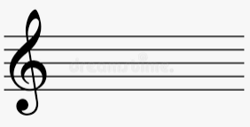

Write the notes C & D
TRY
Reading & writing music
Draw 5 lines
Try drawing a treble clef

Slide 12
What have we learned in
Lesson 6 of Bollywood Brass?
Improvising
Where India and Pakistan is
Playing and reading the notes
C and D
Listening to
changes in pitch

