Slide 1
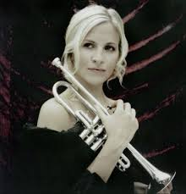
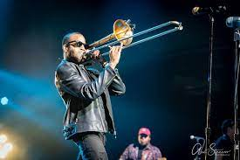
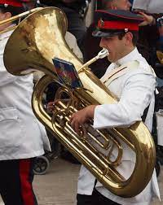
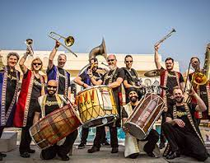
Welcome back to…..
Planet Brass!
With Mr. Rose

Slide 2
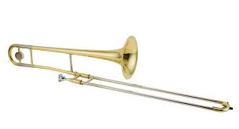
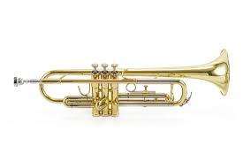
Autumn Term ….. Bollywood Brass
Lesson 5 – Brass!!

Slide 3
Moving to rhythms ……
glide
stride
walk
jogging
Notes:
Perform a line at a time,
Do in 3 groups, group 2 start after group 1 finishes first line

Slide 4
Moving to rhythm cards ……
Notes:
Perform a line at a time,
Do in 3 groups, group 2 start after group 1 finishes first line

Slide 5
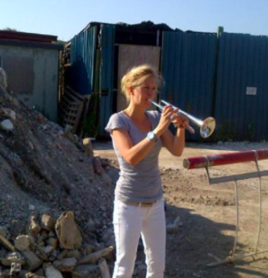
Alison Balsom
Alison Louise Balsom was born in Hertfordshire.
She showed very early promise with the trumpet, taking lessons at school.
Alison has won no less than three Classic BRIT Awards.
When she discovered there was nowhere to practise at an airport, Alison took to a disused building site.

Slide 6
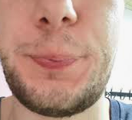
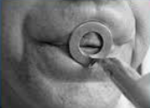
Revision – How to BUZZ
3. Leave a small gap (aperture)
1. Tiger Teeth
2. Feed the tiger
4. Put a mouthpiece to your lips

Slide 7
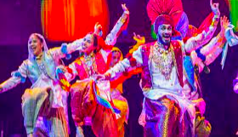
Let’s play Bhangra Style! –
Copy the Teacher on a mouthpiece

Slide 8
Let’s play ‘Play Bhangra Style!’ –
with the trumpet/trombone

Slide 9
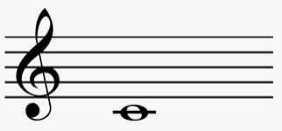
Our first note - C
Reading music
5 lines
Adding a treble clef

Slide 10
Read the rhythms
Copy the teacher
Make up your own rhythms

Slide 11
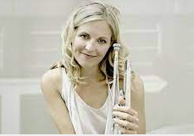
What have we learned in Lesson 5 of Bollywood Brass?
Reading rhythms
How to buzz our lips
The parts of trumpet or trombone
Playing and reading the note C
About Alison Balsom, a famous trumpet player

