Slide 1

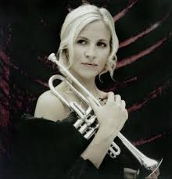
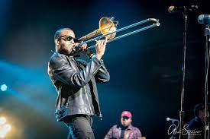
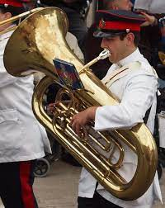
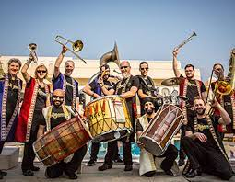
Welcome back to…..
Planet Brass!
With Mr. Rose

Slide 2
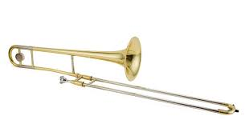
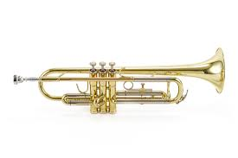
Autumn Term ….. Bollywood Brass
Lesson 4 – Brass!!

Slide 3






walk
Moving to rhythms ……
stride
Notes:
Perform a line at a time,
Do in 3 groups, group 2 start after group 1 finishes first line

Slide 4




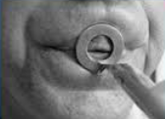
Learning to BUZZ
3. Leave a small gap (aperture)
1. Tiger Teeth
2. Feed the tiger
4. Put a mouthpiece to your lips

Slide 5
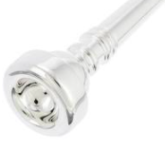
Parts of the brass instrument
Put the case on the floor/table
2. Carefully open the case
3. Take out the mouthpiece
mouthpiece

Slide 6
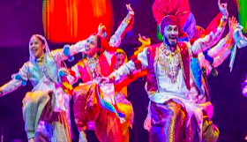
Let’s play Bhangra Style! –
Copy the Teacher (mouthpiece only)

Slide 7
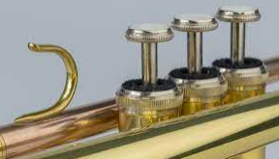
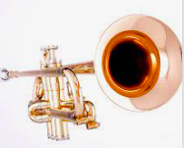
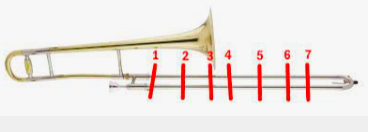
Parts of the brass instrument
mouthpiece
valves
slide
bell

Slide 8
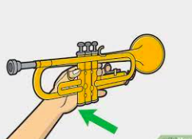
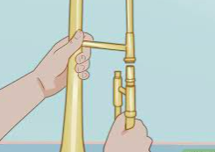
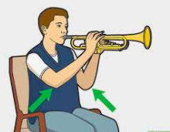
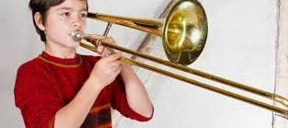
Holding the instrument
‘shake hands’ with the trumpet using your left hand
Put the lock on the slide and connect to the bell
Thumb at the front and little finger at the back. Middle fingers on the valves
Then hold as shown

Slide 9
Let’s play ‘Play Bhangra Style!’
– with the trumpet / trombone

Slide 10

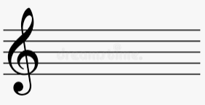
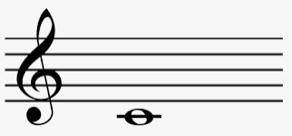
Our first note - C
Reading music
5 lines
Adding a treble clef

Slide 11
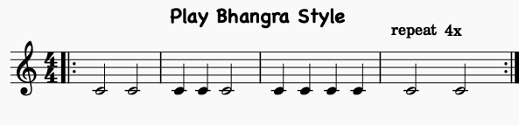
Copy the teacher
Make up your own rhythms

Slide 12
What have we learned in
Lesson 4 of Bollywood Brass?
Reading rhythms
How to buzz our lips
How to play a trumpet or trombone
Playing the note C
improvising

