Slide 1
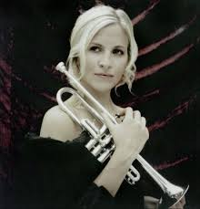
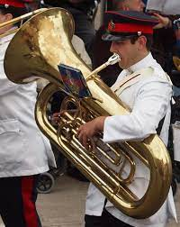
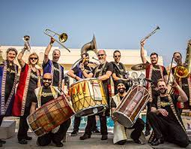
Welcome back to…..
Planet Brass!
With Mr. Rose

Slide 2
Autumn Term ….. Bollywood Brass
Lesson 3 – Putting Rhythms Together and Composing Using Pitch!

Slide 3
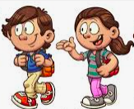
Moving to rhythms ……
stride
walk
jogging
glide
Can you perform more than 1 rhythm in a group?

Slide 4
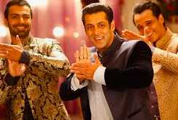
Playing a repeated RHYTHM
Jai Ho!
Work with a partner and decide what rhythm you can play to accompany this music. First using body percussion then on a dhol!
Notes:
Play keeping the beat games such as STOMP, clap on beats 1or 3 etc.
Do it over 8 beats – use a mix of rhythms and keeping the beat

Slide 5
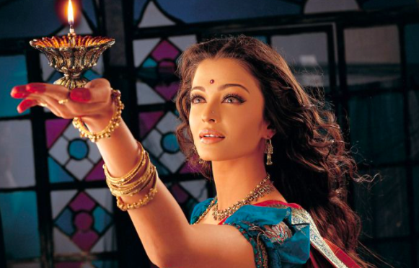
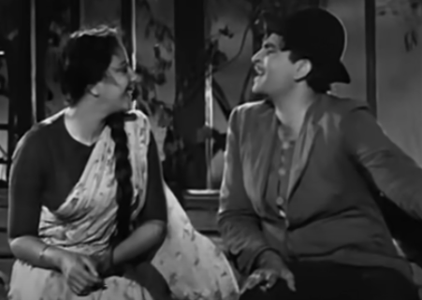
Scenes from Bollywood films

Slide 6
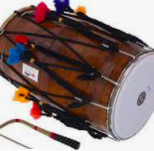
Play this ‘High / Low’ music
Sing “High/Low Chicka Low”
Compose your own ‘High / Low’ music

Slide 7
Bollywood Mash-Up ….
putting different rhythms together!
mashed potato
high and low
Bollywood music

Slide 8
What have we learned in Lesson 3 of Bollywood Brass?
Putting rhythms together
The names of different rhythms
Composing using pitch
The ‘mashed potato’ rhythm
Making up your own rhythms

