Slide 1

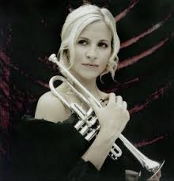
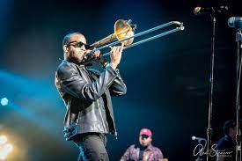
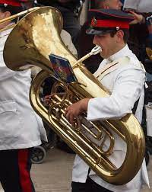
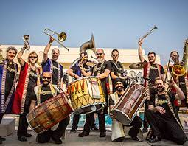
Welcome back to…..
Planet Brass!
With Mr. Rose

Slide 2
Autumn Term ….. Bollywood Brass
Lesson 2 – RHYTHM & PITCH

Slide 3

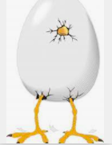
Has anyone finished their Booklet?
If so, let’s see what you’ve done
If not…get cracking!!

Slide 4
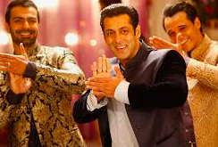

Keeping a steady beat
(feeling the pulse)
Jai Ho!
Notes:
Play keeping the beat games such as STOMP, clap on beats 1or 3 etc.
Do it over 8 beats – use a mix of rhythms and keeping the beat

Slide 5


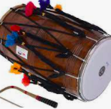
Let’s play ‘High / Low’
The dhol has a high sound and a low sound
Listen to the sound

Slide 6

dagga
dhol
thilli
Let’s move!
Can you make up your own rhythms over a beat of 4?
walk
jogging
stride
Notes:
Remind how the dagga and thilli are used and how to hold, where to hit the dhol (dagga in middle-GE, tilli on rim –NA)
Teacher plays walk, jogging and stride. Pupils move to it.
Invite a few pupils to come up and play along with the music, keeping the beat, (extension, play stride, walk and/or jogging)
Pupils copy teacher rhythm

Slide 7

North, south, east, west
Who can play the dhol the best?
North, south, east, west,
Put your skills to the test!
Notes:
Have 2 dhols prepared
Sit pupils in a circle and learn the rhyme
Pass 2 objects around the circle. Stop the music
Whoever is holding the objects come to centre of the circle and have a conversation with the dhols, questions and answer/call and response, play backing track as they do so, encourage use of pulse and rhythms
Ask class about beat and rhythms, how well were they played
Repeat

Slide 8
What have we learned in
Lesson 2 of Bollywood Brass?
That a dhol has a high sounding side and a low sounding side
Copying different rhythms on a dhol
How to listen carefully to high and low sounds
Making up your own rhythms using ‘Walk, Stride, Jogging’

Slide 10
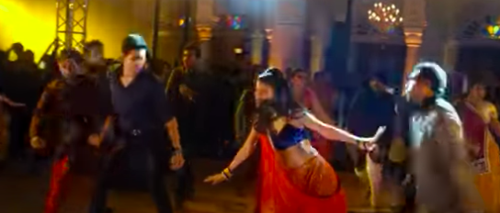
Watch this clip of Bollywood dancing from a film, then design the front page of your project book.
Next time we’ll be looking at ‘rhythm and pulse’
https://www.youtube.com/watch?v=1QlZiPY_SlA

