Slide 1

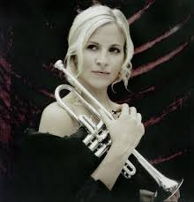
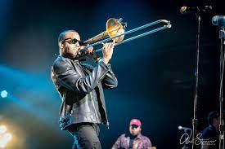
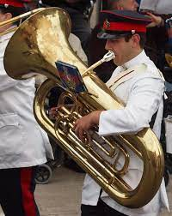
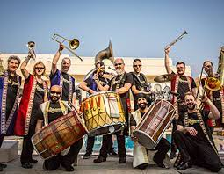
Welcome back to…..
Planet Brass!
With Mr. Rose

Slide 2
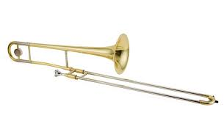
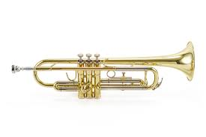
Autumn Term ….. Bollywood Brass
Lesson 10 – Rehearse and Perform!

Slide 3




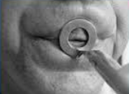
Revision – How to BUZZ
3. Leave a small gap (aperture)
1. Tiger Teeth
2. Feed the tiger
4. Put a mouthpiece to your lips

Slide 4
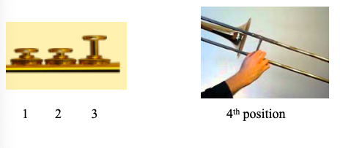
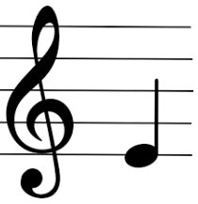
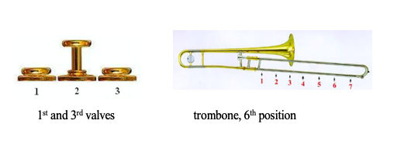
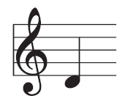
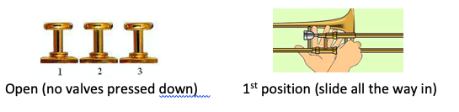
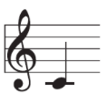
E
D
C

Slide 5
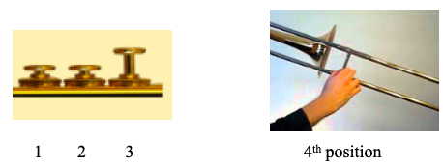

Copy Me – Answer me……
Either copy the melodic phrase you hear
or answer it with one of your own.
E
D
C
Notes:
Perform a line at a time,
Do in 3 groups, group 2 start after group 1 finishes first line

Slide 6
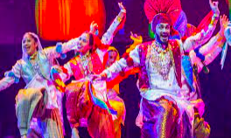
Play Bhangra Style using the note C
We’re gonna play in Bhangra Style
We’re gonna play in Bhangra Style
Yes…..Yes……. We will play it like this

Slide 7
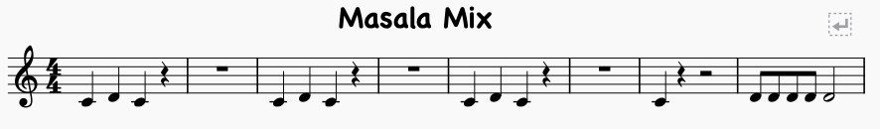
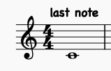
Let’s Play….
The MIDDLE 8

Slide 8
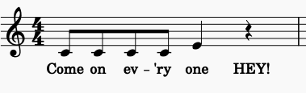
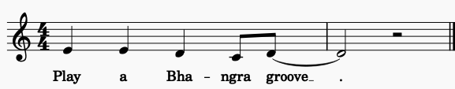
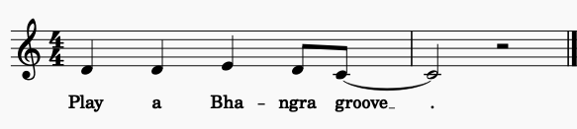
Bhangra Groove
1.
2.
Learn each melodic phrase – 1, 2 and 3
3.

Slide 9
How to perform?

Slide 10
What have we learned in
Lesson 10 of Bollywood Brass?
Playing and reading the notes
C , D and E
How to rehearse and perform to an audience
Reviewing a performance

