Slide 1
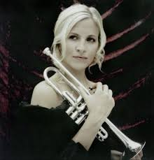
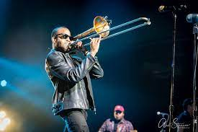
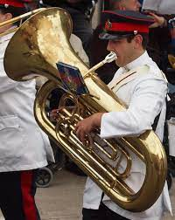
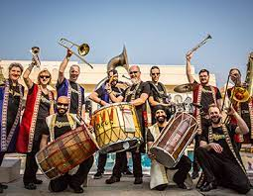
Welcome to…..
Planet Brass!
With Mr. Rose

Slide 2
Autumn Term – Bollywood Brass

Slide 3
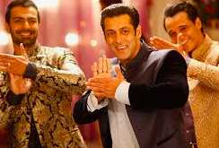
Keeping a steady beat (feeling the pulse)
Jai Ho!
Notes:
Play keeping the beat games such as STOMP, clap on beats 1or 3 etc.

Slide 4
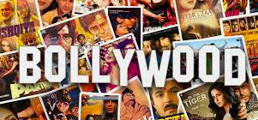
What is Bollywood Music?
Bollywood is India’s equivalent to Hollywood
Music from Bollywood films
The films are colourful..with goodies and baddies
The music is a mix of Asian folk, Bhangra, jazz and funk!
…. often are a love story and are funny

Slide 5
What we’ll be learning this term….
How to play a brass instrument
How to play the dhol drum
About Bollywood films and its music
About music

Slide 6
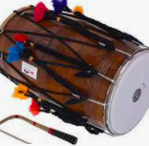
dhol
dagga
thilli
Let’s move!
walk
jogging
stride
Notes:
Teacher plays walk, jogging and stride. Pupils move to it.
Show pupils how to hold the dagga and tilli, demo at the front, invite pupils
Invite pupils to come up and play along with the music, keeping the beat, increase number of dhols

Slide 7
What have we learned in Lesson 1 of Bollywood Brass?
The rhythms of walk, jogging & stride
Dagga & tilli
The main features of Bollywood films and music
The names of the beaters for a dhol.
How to keep a steady beat on a dhol

Slide 8
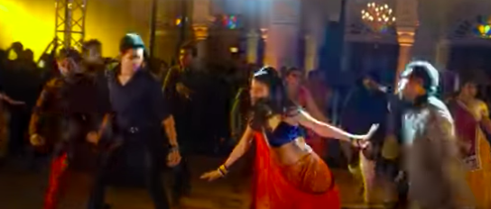
Watch this clip of Bollywood dancing from a film, then design the front page of your project book.
Next time we’ll be looking at ‘rhythm and pulse’
https://www.youtube.com/watch?v=1QlZiPY_SlA

