Slide 1
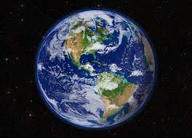
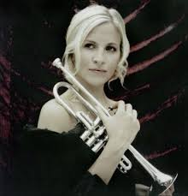
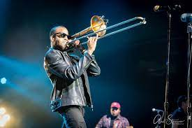
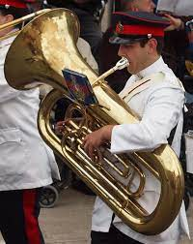
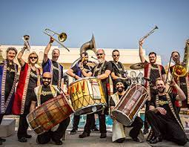
Welcome to…..
Planet Brass!
With Mr. Rose

Slide 2
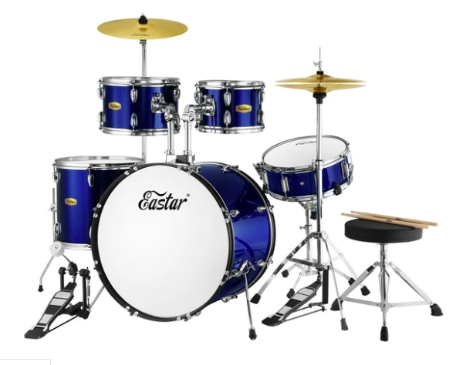
Warm up
Are you ready …… ‘cos you’re in for a treat?
Are you ready ….with your fingers and feet?
Are you ready…can you feel the beat?
We are the human drum kit!
Boom, boom, goes the big bass drum
Listen to the high hat tsch, tsch
Crash on the cymbal “sshh……………………..”
cymbal
High- hat
Bass drum

Slide 3
Your Booklet
Marcus Rashford
Emma Raducanu

Slide 4
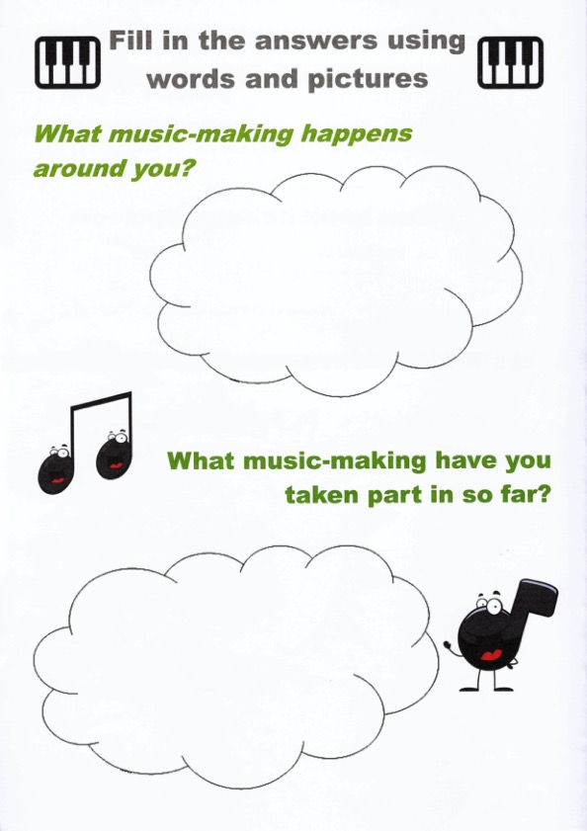
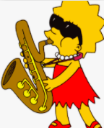
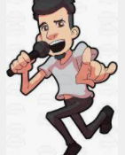
In my house……..
In school……..
On tv……..
I have played …….
I have sung……..

Slide 5
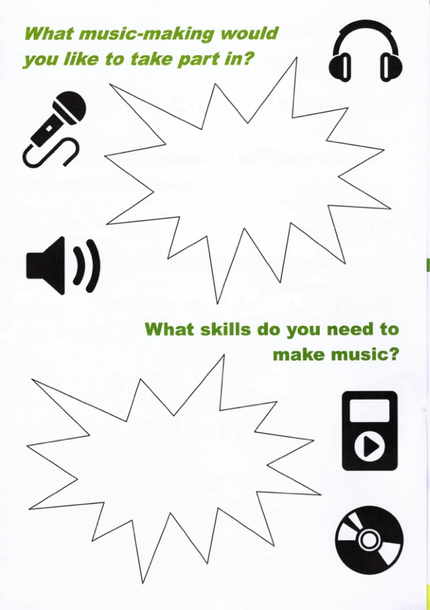
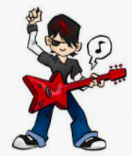

Slide 6
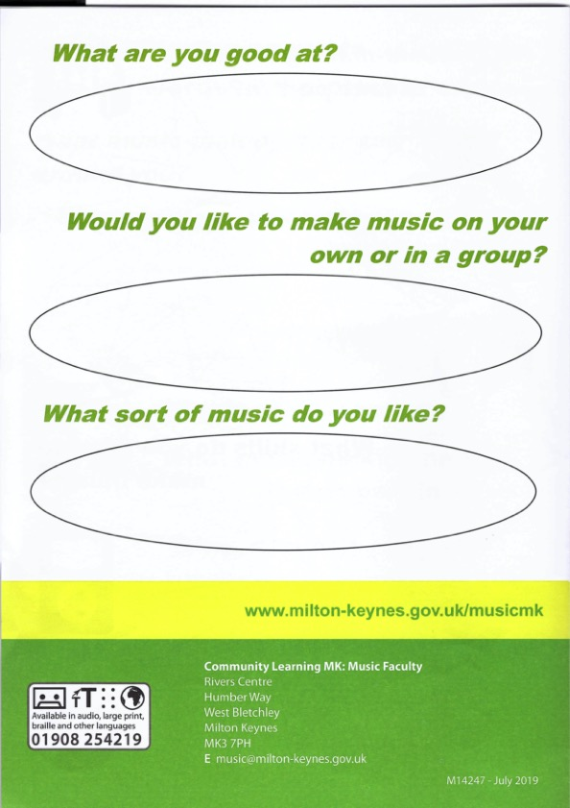

Slide 7
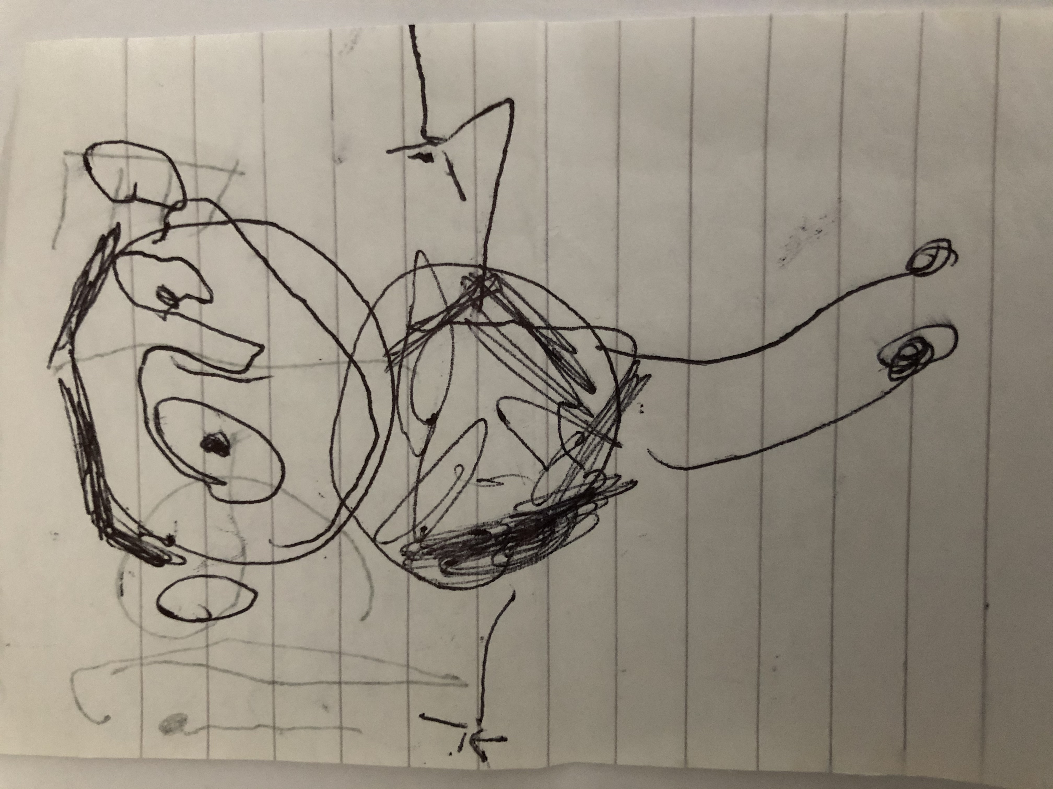
See you next week!

